Slide 1

Comparing Our Promotions!

Slide 2
What Are we Trying to Find?
The effectiveness of three distinct marketing promotions in increasing sales at a fast-food chain.
The most successful promotion.
Null Hypothesis
There is no difference in mean sales between the two promotions being compared.
Alternative Hypothesis
There is a difference in mean sales between the two promotions being compared.

Slide 3
How Did We Measure?
Sales in thousands (total weekly sales per location by promotion).
Directly tied to revenue, making it the key indicator of campaign success.

Slide 4
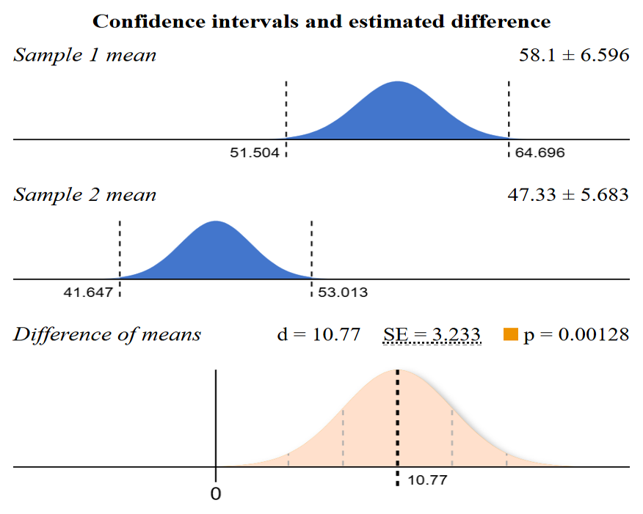
1 vs 2
Promotion 1 vs. Promotion 2
Treatment effect: +10.77
Lift +22.75%
P-value: 0.0013 (Statistically significant at 0.01 level).
Conclusion: Promotion 1 significantly outperforms Promotion 2.

Slide 5
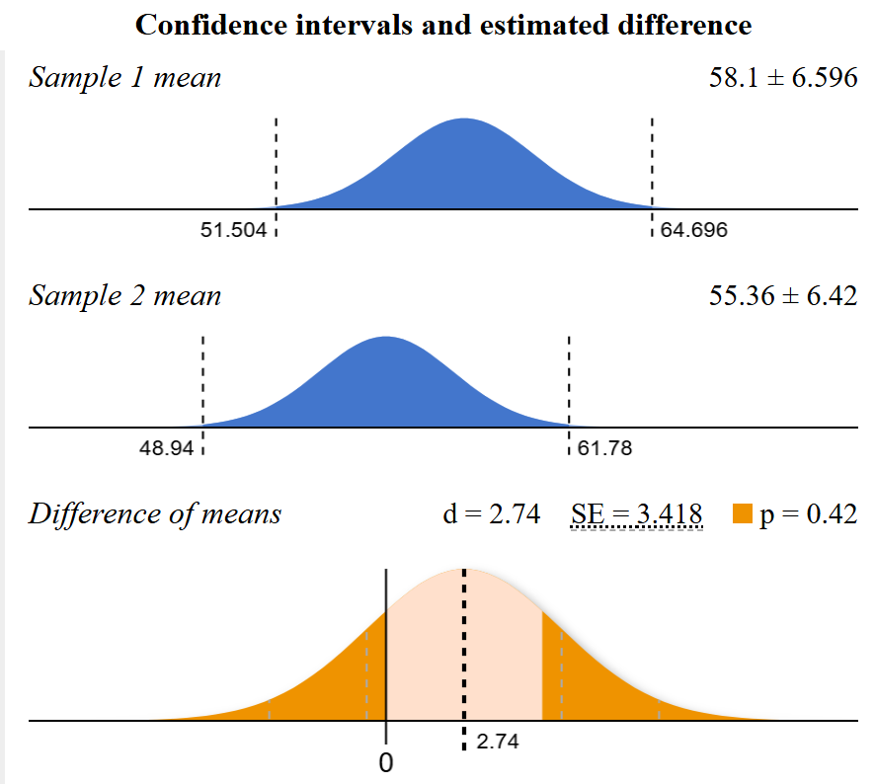
1 vs 3
Promotion 1 vs. Promotion 3
P-value: 0.4259 (Not statistically significant).
Lift +4.95%
Conclusion: Similar sales performance.

Slide 6
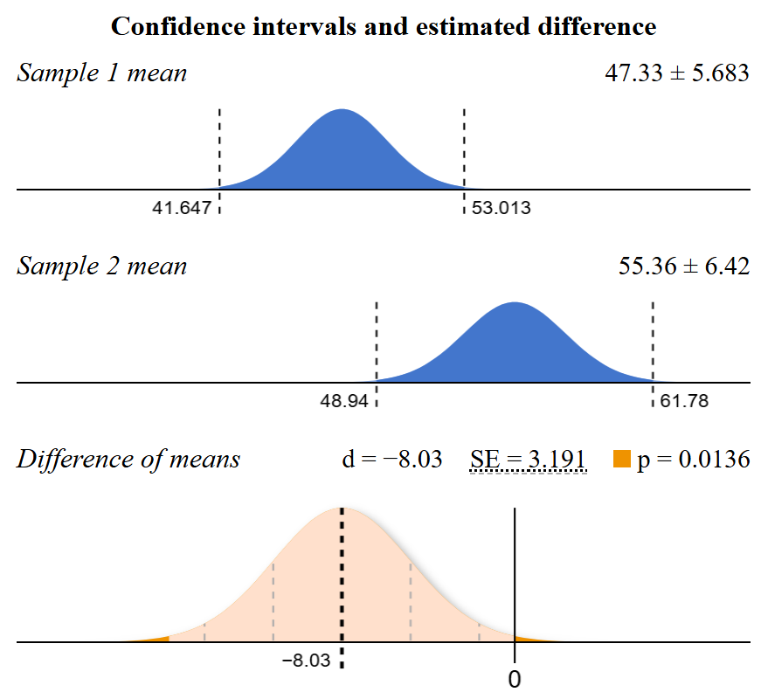
2 vs 3
Promotion 2 vs. Promotion 3
Treatment effect: -8.04
Lift: -14.51%
P-value: 0.0136 (Not statistically significant at 0.01 level).
Conclusion: No significant difference; Promotion 3 slightly outperforms Promotion 2.

Slide 7
Recommendations and Next Steps
Recommendations
Prioritize Promotion 1: Scale to maximize sales.
Consider Promotion 3: Use if Promotion 1 is not feasible.
Reevaluate Promotion 2: Adjust strategy or discontinue.
Next Steps
Analyze drivers behind Promotion 1’s success.
Assess operational feasibility for scaling Promotions 1 & 3.
Explore improvement opportunities for Promotion 2.

